Slide 1
Holt High School Band Boosters
Annual Meeting
May 9 , 2023

Slide 2
Agenda
Welcome
Board of Director Updates
Boosters Financial Updates-Treasurers Report
Key Dates Going Forward
Volunteer Opportunities
Fundraising Activities
Shoes
Band Director’s Report
Elections
Band Camp Planning
Next Meeting-Ice cream social in August
Adjournment

Slide 3
Board of Director Reports
Matt Lincoln Vice President
MariaRosa Palmer Secretary
Lori Underhill Treasurer
Jenn Elliott Asst Treasurer
Patty Dokum Uniform Committee
Dawn Carmody Volunteer Committee
Ann-Marie Lindley Fundraising Committee

Slide 4
Treasurer’s Reports
April ,2023
Beginning Balance (All Accounts) – April 1,2023 $33,911.00
Ending Balance (All Accounts) – April 30,2023 $29,344.06

Slide 5
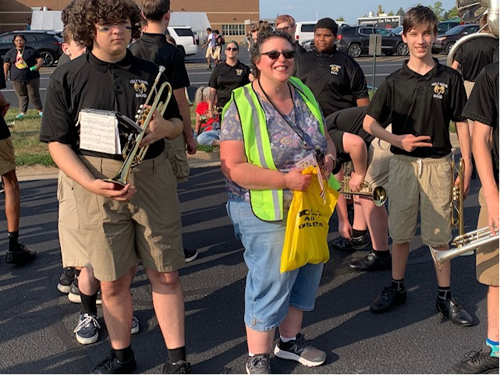
Volunteer Opportunities/Upcoming EventsatesGoing Forward
Event | Event Date | Comments
Jazz Band @High School Awards Night | May 17, 2023 | Arrive @6p
Spring Concert and Awards Night | May 18. 2023 | 7pm
Memorial Day Parades | May 29, 2023 | Volunteers(parade walkers, lunch)
Band Camp Planning | Early June | TBD

Slide 6
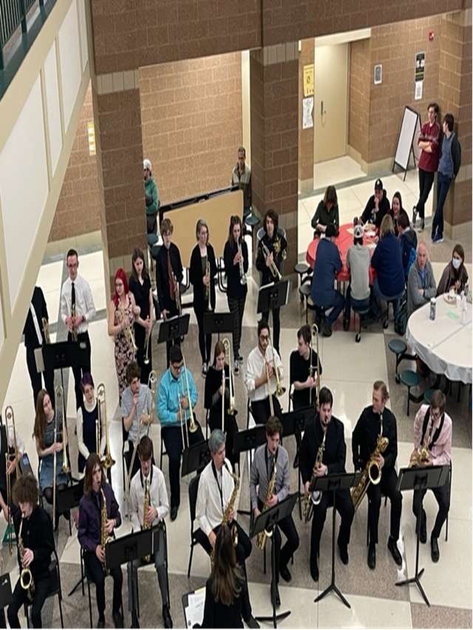
Fundraising Activities/Planning
Slides/Shoes( in support of the Band Director)

Slide 7
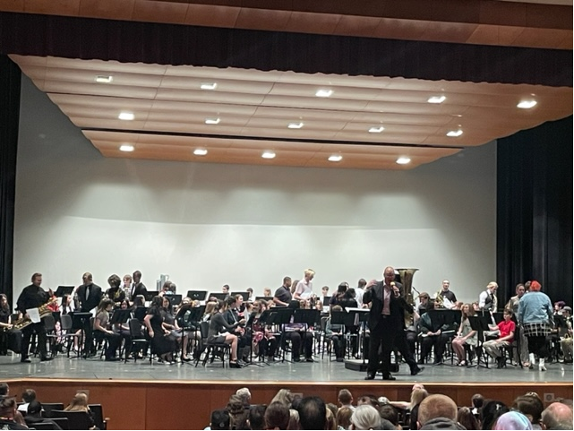
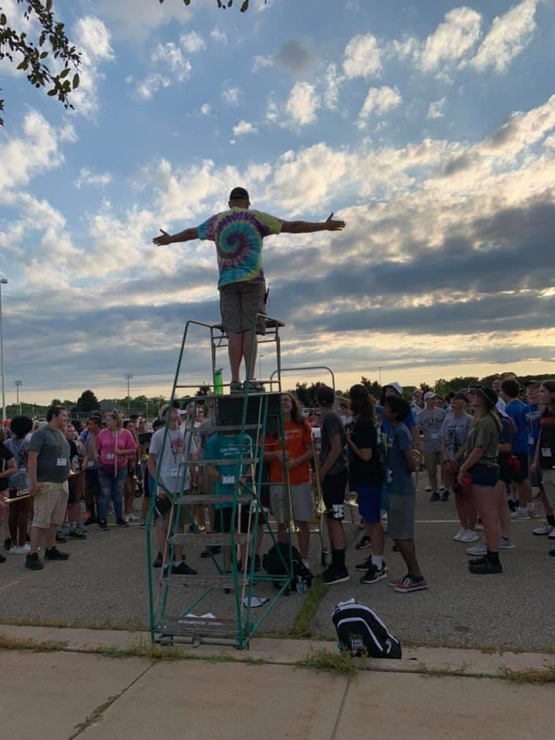
Band Director Report
.

Slide 8
Elections
Treasurer
Assistant Treasurer

Slide 9
Don’t Forget Our Web Site
www.holtbandboosters.com

Slide 10
…..And Facebook Page….

Slide 11
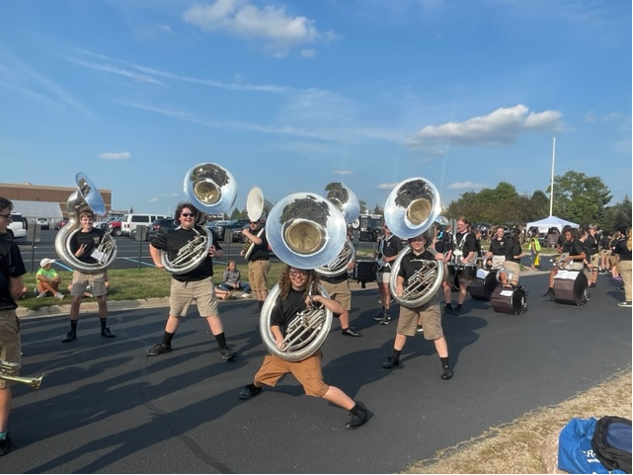
Next Meeting August , 2023 Thank You For Joining!

