Slide 1
Holt High School Band Boosters
General Meeting
April 11, 2023

Slide 2

Agenda
Welcome
Board of Director Updates
Boosters Financial Updates-Treasurers Report
Key Dates Going Forward
  Volunteer Opportunities
Fundraising Activities
  Band Festival
  Band-Aid
Band Director’s Report
Open Discussion
Next Meeting-May 9, 2023, 7 p.m.
Adjournment

Slide 3


Board of Director Reports
Matt Lincoln Vice President
MariaRosa Palmer Secretary
Lori Underhill Treasurer
Jenn Elliott Asst Treasurer
Patty Dokum Uniform Committee
Dawn Carmody Volunteer Committee
Ann-Marie Lindley Fundraising Committee

Slide 4
Treasurer’s Reports
March,2023
Beginning Balance (All Accounts) – March 1,2023 $26,137.93
Ending Balance (All Accounts) – March 31,2023 $33,911.00

Slide 5
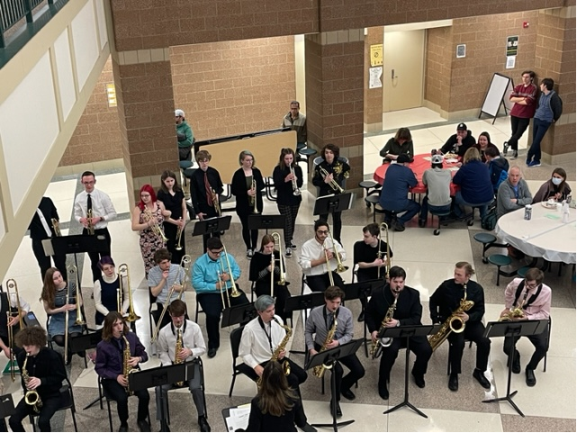
Volunteer Opportunities/Upcoming EventsatesGoing Forward
Event | Event Date | Comments
Wind Ensemble Tri-District Concert | April 19, 2023 | Location TBD 6pm
Jazz Band – Top 10 Dinner | April 24, 2023 | Sam Corey Senior Center Arrive @530p
Jazz Band at Thornapple Jazz Fest | April 28, 2023 | @ Hastings
Jazz band “HEF” Dinner | May 3, 2023 | @ Hidden Gem in Holt arrive @5:40p
Jaxx Band Holt High School Awards Night | May 17, 2023 | Arrive @ 6p
Spring Concert Awards Night Jazz Band Pre-Music | May 18, 2023 | Auditorium and Commons
Memorial Day Parades | May 29, 2023 | Holt/Dimondale

Slide 6
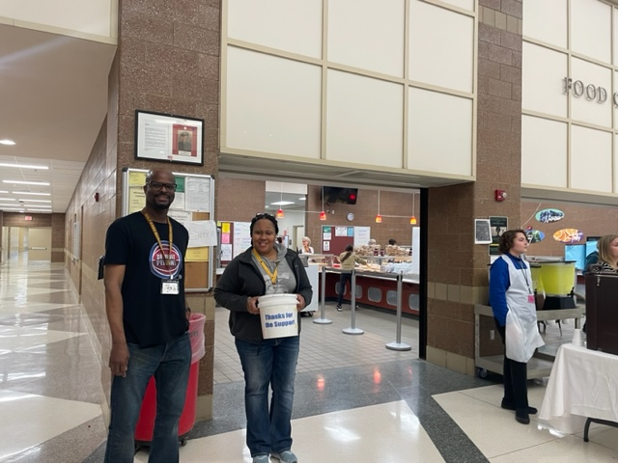
Fundraising Activities/Planning
Band Aid- 50/50 Raffle and Spaghetti Dinner – Great job!
Memorial Day Parades
Spirit Wear
Band Camp
Band Photos

Slide 7

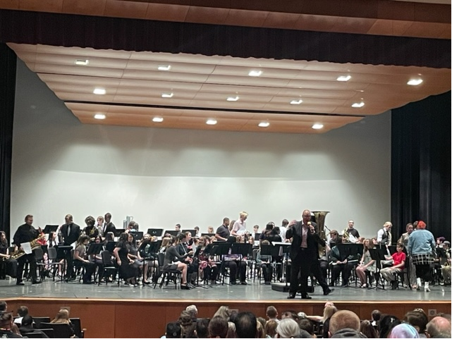
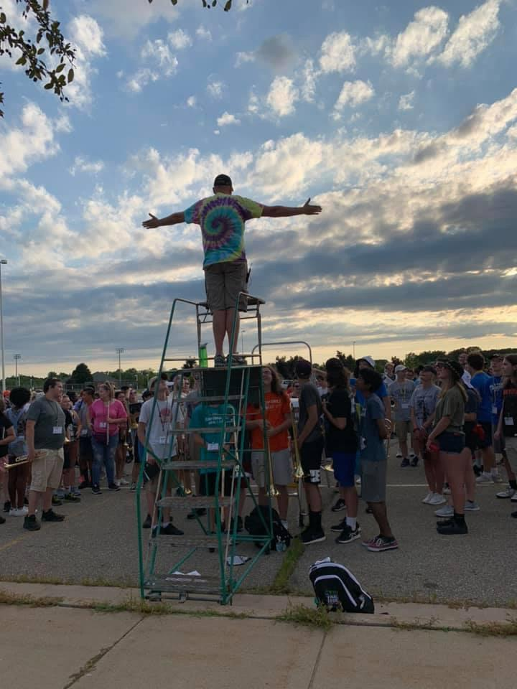
Band Director Report
.

Slide 8

Don’t Forget Our Web Site
www.holtbandboosters.com

Slide 9
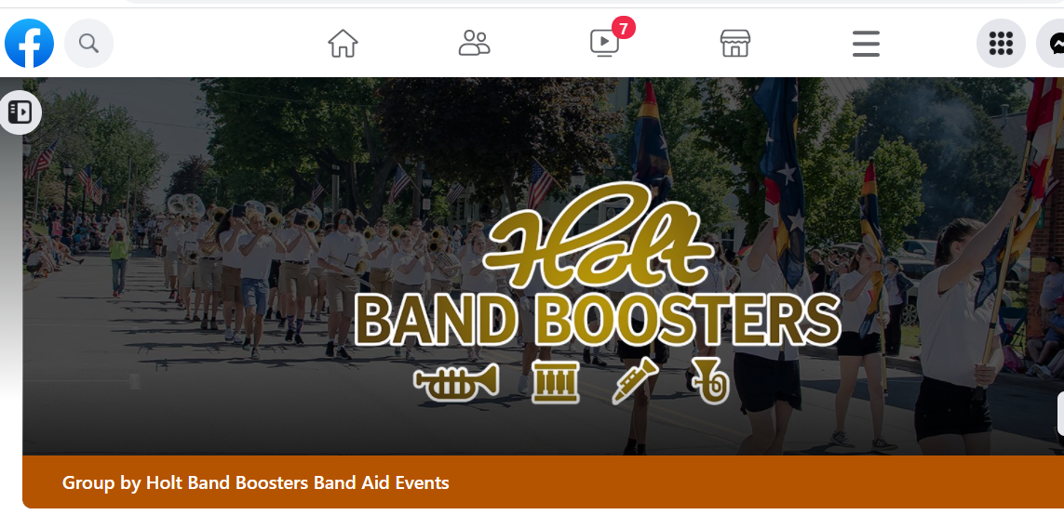
…..And Facebook Page….

Slide 10

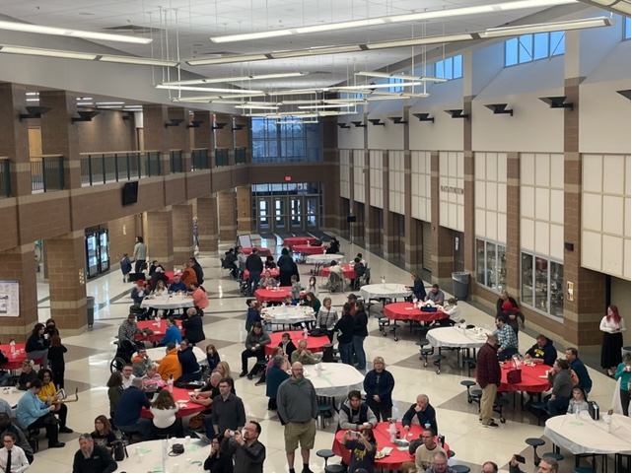
Next Meeting
May 9, 2023
Thank You For Joining!

